Slide 1
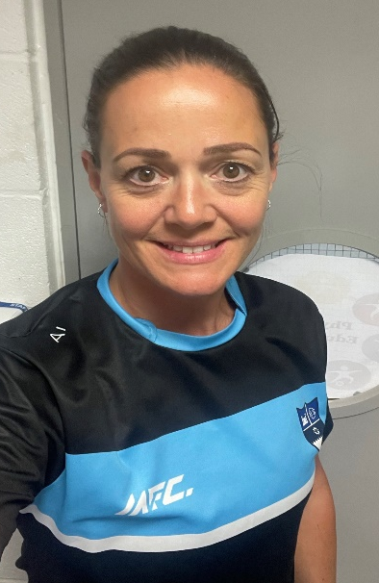
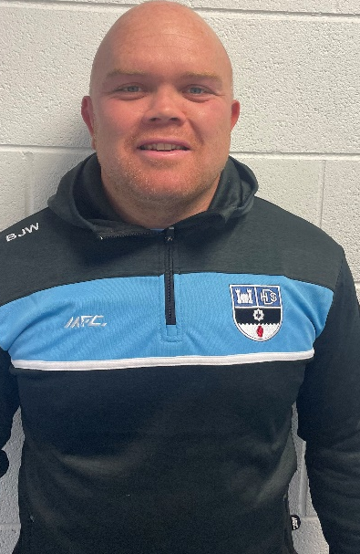
Welcome to P.E
Mrs Irvine & Mr Wilson

Slide 2
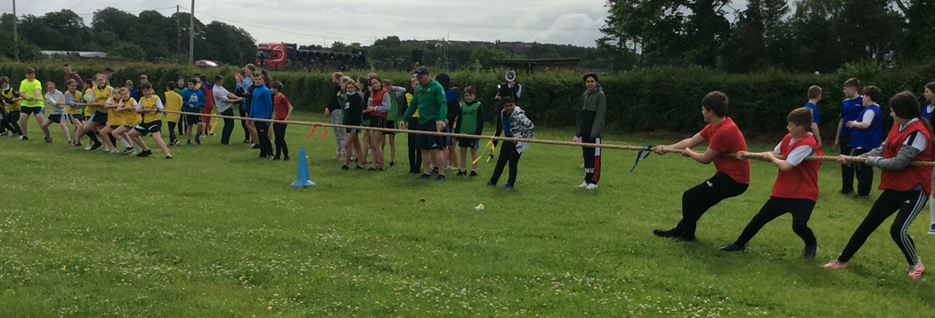
Our Aims
To have maximum participation in all lessons/clubs.
Ensure all lessons/clubs are filled with fun while pupils learn and develop skills in a safe environment.

Slide 3
PE Kit – (Supplied by MFC)
*Compulsory Kit *Optional Kit
BOYS | GIRLS
School PE T-Shirt (White/Black) | School PE Shirt (Black/ White)
School Shorts (Black) | School skorts/shorts (Black)
Socks (Black/White) | Socks (Black/White)
Laced Trainers & Football Boots | Laced Trainers
School ½ zip top School training/ rugby top School Jumper | School ½ zip top School training top School Jumper
School Skinnies | School skinnies/ leggings
Notes:
Trainers – slip ons or sticky.
All kit should be clearly labelled
No tights!

Slide 4

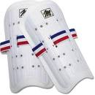

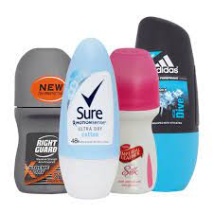

What else might you need.
Bottle of Water
Mouth guards (purchased in school £2)
Shin guards
Roll on deodorant
Asthma users bring inhalers

Slide 5

PE RULES
NO BULLYING
NO BAD LANGUAGE
LOOK AFTER EQUIPMENT
LISTEN TO INSTRUCTIONS
TRY YOUR BEST

Slide 6
PE activities 2023-24
Girls | Boys
Netball Swimming (Yr8) Trampolining Volleyball Badminton Athletics Tennis Rounders Hockey | Rugby Swimming (yr8) Basketball Volleyball Badminton Athletics Tennis Softball Cricket

Slide 7
AP | Activities
1 | Invasion Games
2 | Net games/Swimming
3 | Athletics & striking games

Slide 8
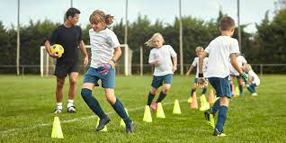
Assessment
You will be assessed on:
Effort
Behaviour
Performance

Slide 9

Extra Curricular Sport Clubs
No cost (School fund!!)
To join up all you have to do is turn up after school for one of the clubs
Teams will be selected on:
Ability
Fitness levels
Attendance at training

Slide 10
Term 1 After Schools Sports Programme
Day | After school Sports Activity
Monday | U14 Rugby | Mr Wilson
Tuesday | U16 Rugby Fitness Suite | Mr Wilson Miss Reid
Wednesday | U13 Football Key Stage 3 Netball | Mr McAlister Mrs Irvine/ Mrs Hill
Thursday | U15 Football Fitness Suite | Mr Hoines Miss Reid

Slide 11
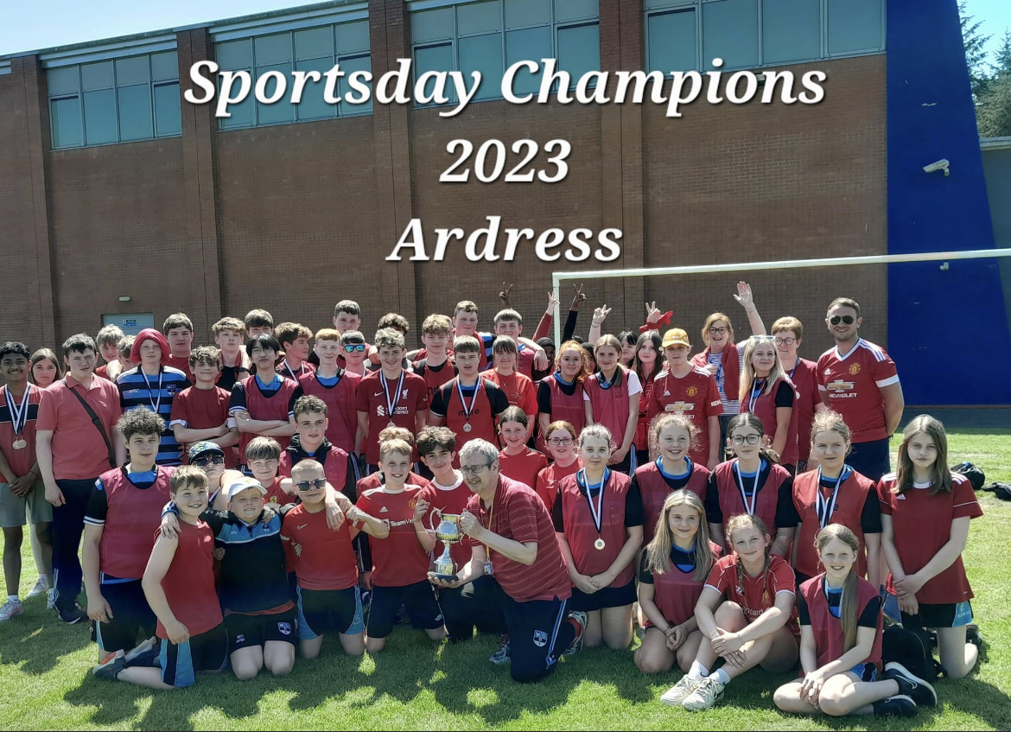
House Competitions
Argory
Springhill
Ardress
Wellbrook

Slide 12
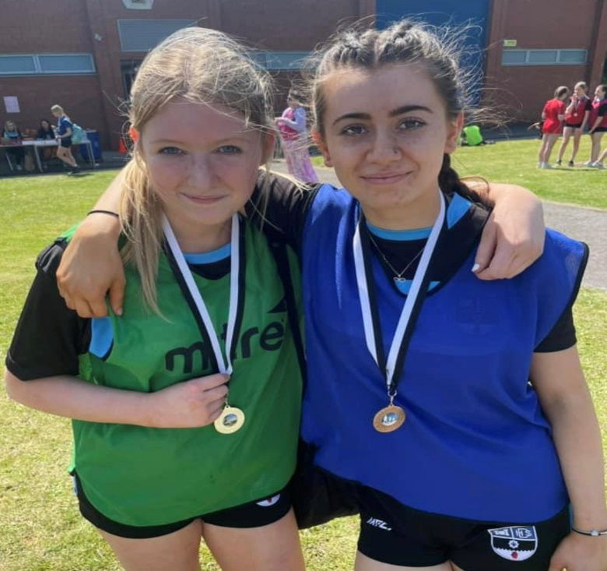
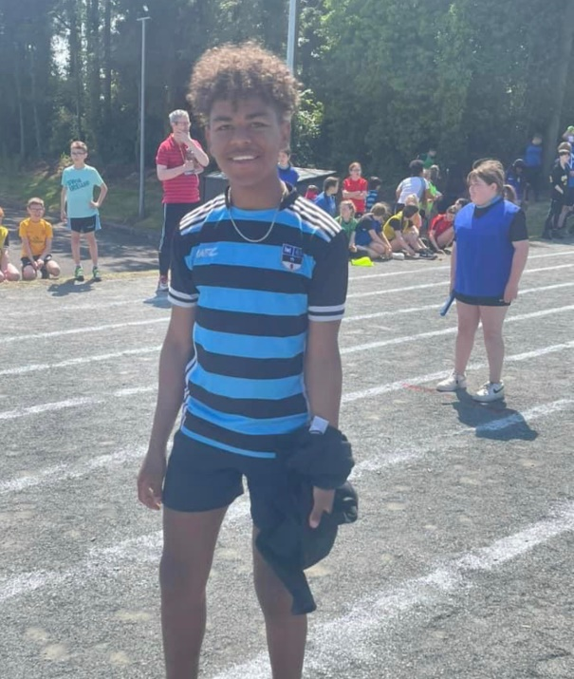
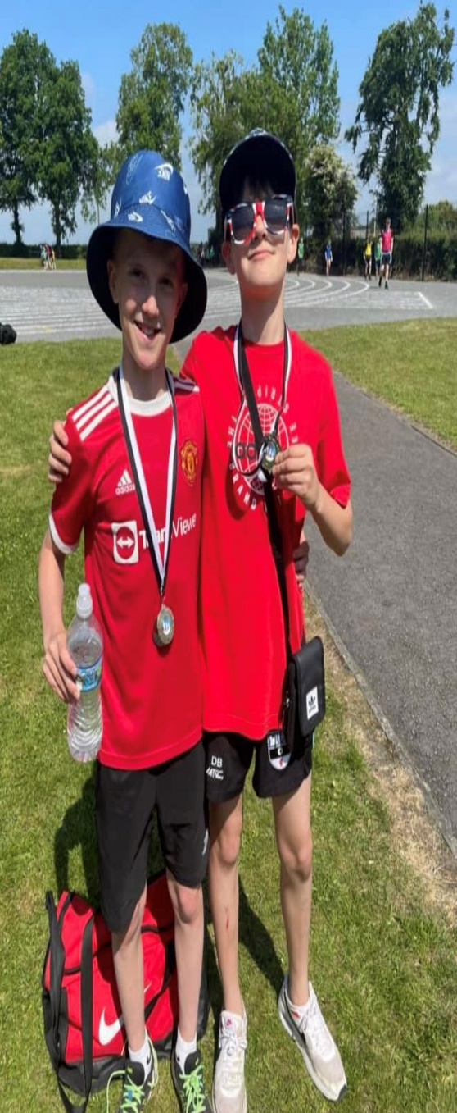
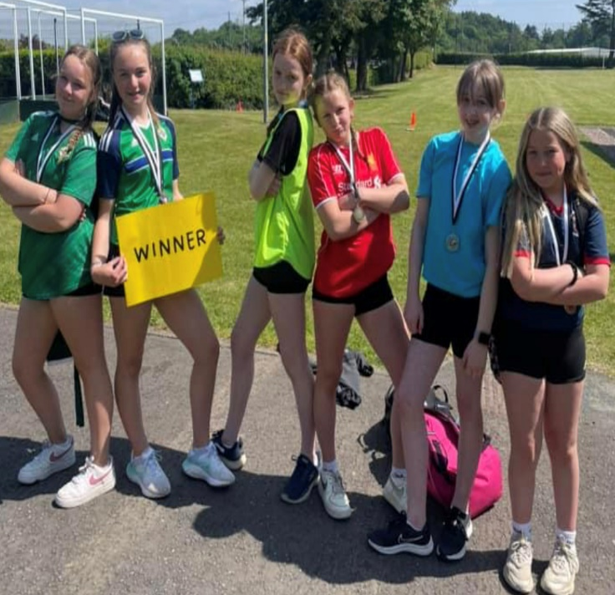
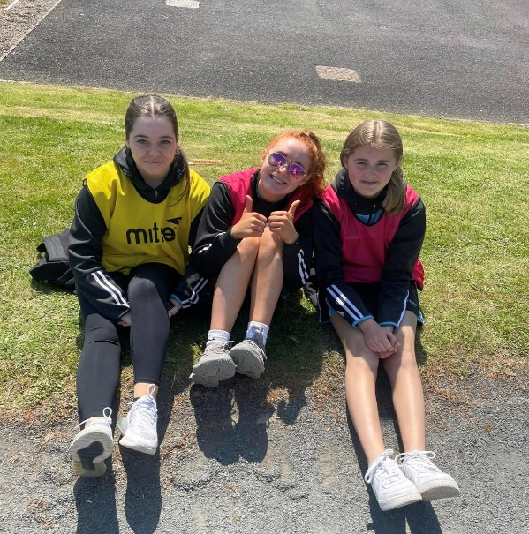
Sportsday

Slide 13
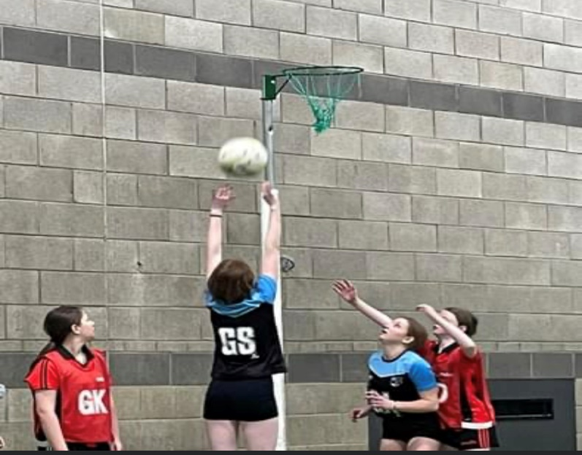
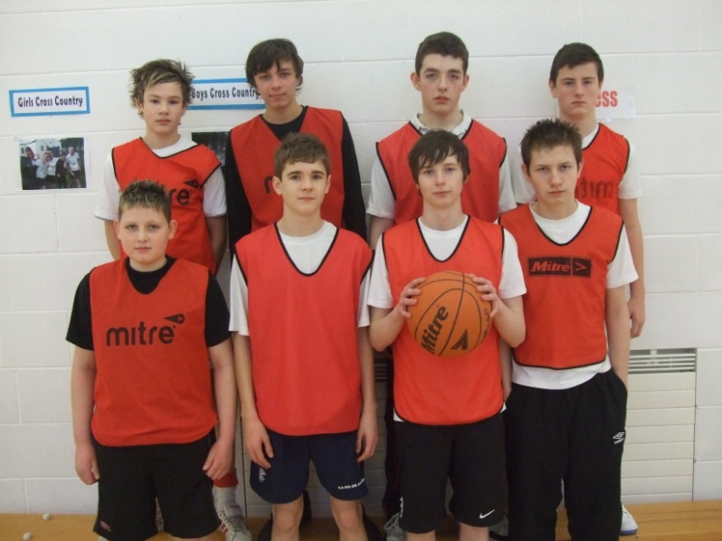
House Competitions
Boys | Girls
Basketball | Netball
5 aside football | Hockey
Badminton
Track and Field athletics (Sports Day)

Slide 14

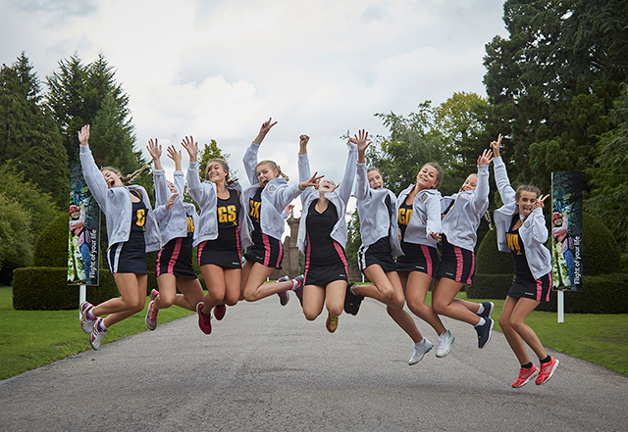
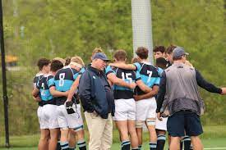
Trips
Rugby and Netball Tour
When : May 2024
Where : England (Manchester)
How long : 2 nights / 3 days
Who: 20 Netball players & 20 Rugby players

Slide 15
Fitness Suite
Induction – how to safely use all the equipment in the fitness suite.
Membership - £10 for whole year (outside of lesson time).
Only Members can use the fitness suite unsupervised.
Fitness suite will be open afterschool (Tuesday & Thursday 2.50-3.50pm)

