Slide 1

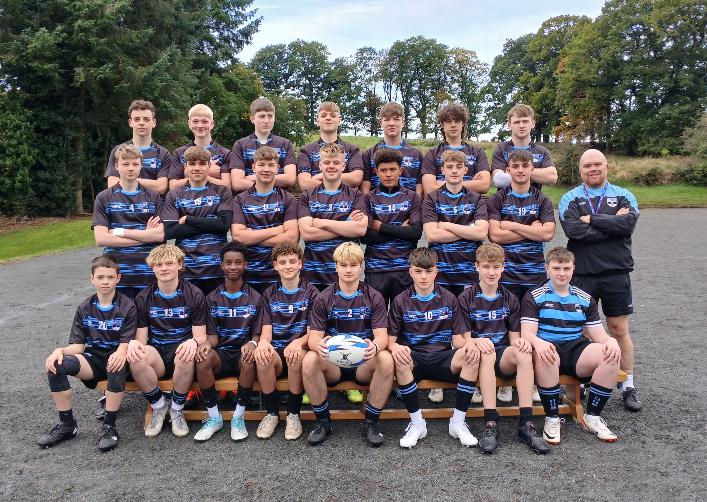
Welcome to the DHS P.E. Dept.

Slide 2

PE Department Aims 2025/26
Maximise Pupil Engagement
Foster a culture of enthusiastic participation in all PE lessons and extracurricular clubs, ensuring every pupil feels encouraged and supported to get involved.
Deliver Enjoyable, Skill-Rich Experiences
Create dynamic and inclusive learning environments where fun and skill development go hand-in-hand, with a strong emphasis on safety, teamwork, and personal growth.
Establish DHS as a Centre of Sporting Excellence
Position Drumglass High School as a beacon of sporting achievement by nurturing talent, celebrating success, and building strong links with local clubs and sporting bodies.

Slide 3
PE Kit – (Supplied by MFC)
*Compulsory Kit *Optional Kit
BOYS | GIRLS
School PE T-Shirt (White/Black) | School PE Shirt (Black/ White)
School Shorts (Black) | School skorts/shorts (Black)
Socks (Black/White) | Socks (Black/White)
Laced Trainers & Football Boots | Laced Trainers
School ½ zip top School training/ rugby top School Jumper | School ½ zip top School training top School Jumper
School Skinnies | School skinnies/ leggings
Notes:
Trainers – slip ons or sticky.
All kit should be clearly labelled
No tights!

Slide 4

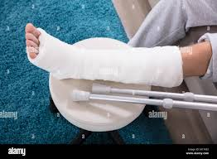
Non-participation
Pupils must bring a note explaining why they are not able to participate in the lesson.
PE notes must be;
Addressed to the PE teacher
Explain why they are not participating
State how long this will be
Signed and dated by parent/guardian
Notes:
More than 3 weeks = doctors note!

Slide 5


Forgetting Kit
Apologise!
Option 1 – Borrow Kit (10p per item)
Option 2 - Complete PE written work in silence
1st time – verbal encouragement & warning
2nd time - Break / Lunch detention
3rd time – Phone call home & Intervention

Slide 6

PE RULES
NO BULLYING
NO BAD LANGUAGE
LOOK AFTER EQUIPMENT
LISTEN TO INSTRUCTIONS
TRY YOUR BEST

Slide 7
KS3 PE activities 2025-26
Girls | Boys
Health Related Fitness Netball Swimming (Yr8) Volleyball Badminton Athletics Trampolining Gymnastics Tennis Rugby Rounders Hockey | Health Related Fitness Rugby Football Swimming (yr8) Basketball Volleyball Badminton Dodgeball Athletics Tennis Softball Cricket

Slide 8
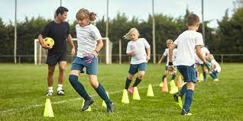
KS3 Assessment
Pupils will be assessed each term on:
Effort
Behaviour
Performance

Slide 9
AP | Activities
1 | Invasion Games
2 | Net games/Swimming (Yr.8)
3 | Athletics & Striking games

Slide 10
Key Stage 4 Options
GCSE PE | OCN NI Level 2 Certificate in Sport
For students on the Academic or Blended Career Pathway. Assessment is 50% Practical and 50% Written exam at the end of year 12. | For students on the Vocational or Blended Career Pathway. Assessment is continuous throughout year 11 & 12 and is 100% written coursework.
All KS4 students get one 50-minute period of Physical Education a week where the focus is on Health-Related Fitness and Games participation.

Slide 11

Extra Curricular Sport Clubs
No cost (School fund!!)
To join up all you have to do is turn up after school for one of the clubs
Teams will be selected on:
Ability
Fitness levels
Attendance at training

Slide 12
Term 1 After School Sports Programme
Day | After school Sports Activity
Monday | Yr. 8&9 Boys Football Primary School Netball | Mr. Wilson Mrs. O’Neill
Tuesday | Yr.9&10 Boys Rugby | Mrs. Ravey Mr. Wilson
Wednesday | Senior Boys Football (yr10-12) Senior Netball (yr10-12) Yr.8 Rugby Yr.8&9 Girls Hockey | Mr. Hoines Mrs Irvine Mr. Wilson Miss Henry
Thursday | Yr.8&9 Netball KS3 Girls Football | Mrs. O Neill

Slide 13
House Competitions
Argory
Springhill
Ardress
Wellbrook

Slide 14
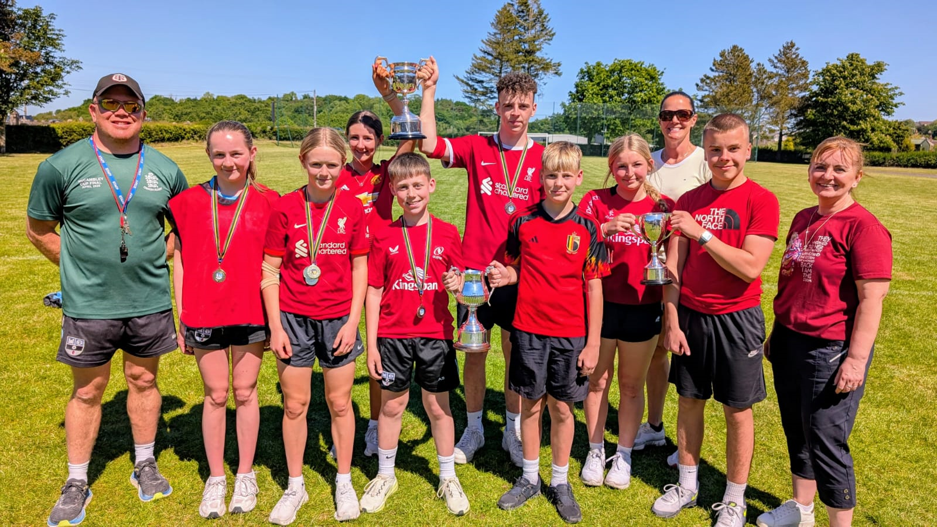
Sportsday

Slide 15
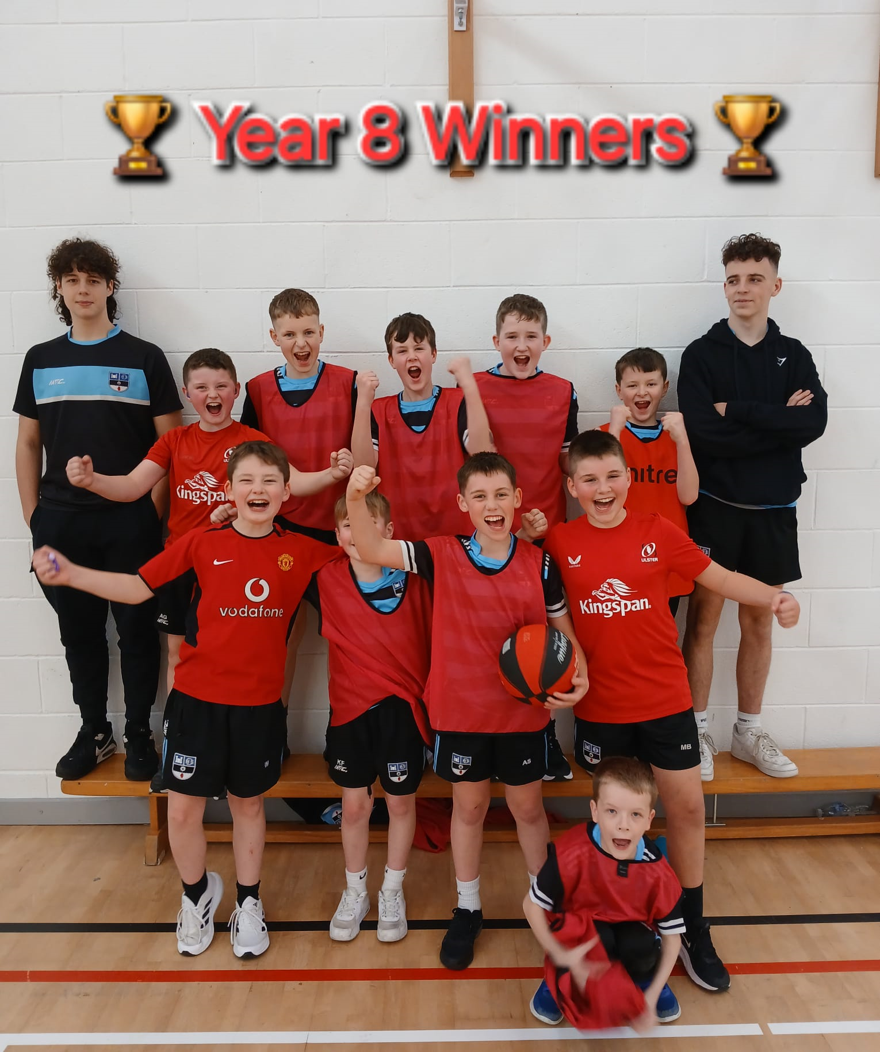
House Competitions
Boys | Girls
Basketball | Netball
Volleyball | Hockey
Track and Field athletics (Sports Day)
Football

Slide 16
Yr.11&12 Fitness Suite
Induction – how to safely use all the equipment in the fitness suite.
Membership - £10 for the whole year (outside of lesson time).
Only gym members can use the fitness suite afterschool.
Fitness suite will be open afterschool (Monday - Thursday 2.50-4pm)

Slide 17
